Slide 1
Monday, Nov. 7
Happy Monday! ☺
Please have your notes and something to write with ready.
Sub on Wednesday and Thursday
Extra Credit Opportunity – Canned Food Drive

Slide 2
Perfect Competition
Market Structure

Slide 3

What is Perfect Competition?

Slide 4
What is a perfect competition?
The simplest market structure is known as perfect competition (pure competition).
A large number of firms that produce essentially the same thing.
There is nothing outside of the market itself that determines the prices – people don’t collectively bargain to lower prices.
There are four conditions for perfect competition:
  Many buyers and sellers in the market
  Sellers offer identical products
  Buyers and sellers are well informed about products
  Sellers are able to enter and exist the market freely

Slide 5

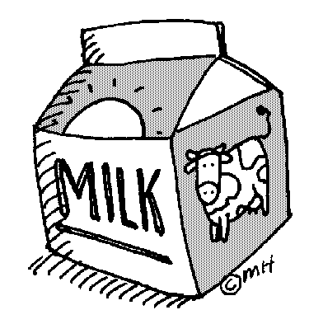
Four Conditions of PC
Many Buyers and Sellers
  Perfectly competitive markets require lots of participants on both sides that are exchanging similar goods.
  No one individual is powerful enough to change the market and influence prices.
  The market determines price without influence
Identical Products
  There are no differences between the products sold by different suppliers
    Ex: gasoline, milk, tomatoes, corn
  A product that is considered the same regardless of who makes it is called a commodity.
  Identical products are key for perfect competition – buyers will not pay extra for one company’s good, they simply buy the cheapest.

Slide 6
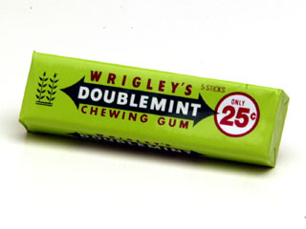
Four Conditions of PC
Informed Buyers and Sellers
  Both must know enough about the market to find the best deal.
  The market provides information for the buyers and the sellers about the features and price of the products.
  For the market to work effectively, buyers and sellers have to have clear incentives to gather more information.
  This involves a trade-off. People will only invest time in gathering information if it will pay off in the end because the time spent is an opportunity cost. Pack of chewing gum example
Free Market Entry/Exit
  Firms have to be able to come and go freely when they can’t make enough money to sustain the business.
  Studies show that markets with more firms and competition have lower prices.
  Firms will only stay in business if they can sell enough to stay afloat.

Slide 7


Barriers to Entry
Are the factors that prevent a business from entering the market.
Barriers can lead to imperfect competition
Barriers include:
  Start up costs
  Technology

Slide 8


Price and Output
Perfectly competitive markets are very efficient.
Competition keeps prices and production costs low.
Firms utilize all of their inputs (F of P) very efficiently and they maximize their production.
Prices are the lowest in a perfectly competitive market to sustain the business. Intense competition among commodities suppliers forces prices down.
Perfect competition exists in industries where the firm will supply just enough of their commodities to cover their costs and pay the owner – which is incentive to stay in business.

Slide 9
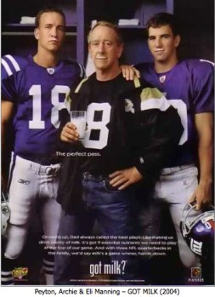
Milk Market
The market for milk represent perfect competition.
All milk suppliers produce the same good and the price is controlled.
Milk farms rarely advertise…. Right? When is the last time you saw a commercial or a “Got Milk?” ad?

Slide 10
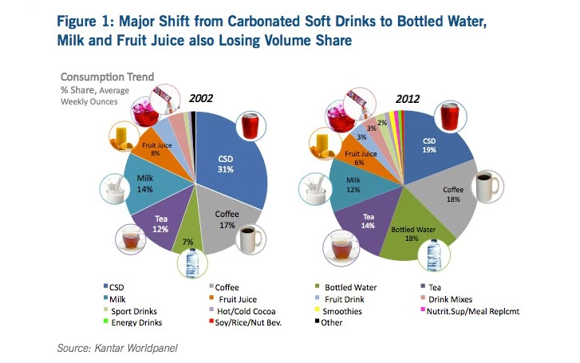
So if milk is so good for us, why are we drinking less of it?
The market for beverages has changed and milk is being overshadowed by other beverage competitors.
Bottom line – milk producers have a hard time competing with each other, and now they have to compete with all these other beverages too.
This represents a perfectly competitive market.

